Slide 1
Hamming Distance
Schematic & Layout (Pyxis Mentor Graphics)
VLSI PROJECT
(EE311)
Group No : 4
Team Members:
Krishna Praveen Y
Abhinav Bollam
Souradip Pal
Saurabh Dhall

Slide 2
Introduction

Slide 3
Idea
The idea of the project is to simulate a circuit that takes 3-bit sequences as input in a serial fashion and calculates the Hamming distance between them giving the output in binary.

Slide 4
About Hamming Distance
The Hamming distance between two strings of equal length is the number of positions at which the corresponding symbols are different. In other words, it measures the minimum number of substitutions required to change one string into the other, or the minimum number of errors that could have transformed one string into the other.
The Hamming distance for 2 binary sequences (S₁ and S₂), each of length of N, can be calculated as follows:
H(S₁ , S₂ )= ∑ [ S_{i1}(1-S_{i2}) + S_{i2}(1-S_{i1}) ] ,
i=1...N

Slide 5
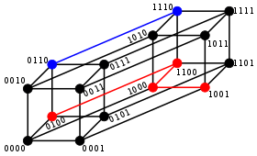
Graphical Representation of Hamming Distance

Slide 6
Working Principle
Sample Test Inputs and Outputs:
Test Input 1: S1 | Test Input 2: S2 | Shift Register Contents(after 3 clocks cycles) | Full Adder Output
000 | 111 | 111 | (11)₂=3
101 | 110 | 011 | (10)₂=2
001 | 000 | 001 | (01)₂=1
010 | 010 | 000 | (00)₂=0
The two sequences are given serially through the 2 input ports and are passed through the XOR gate which calculates the bitwise Hamming distance. The output of the XOR gate is given to the input of the SIPO module which stores the value in a shift register. After the required number of clock cycles the SIPO module contains the bitwise Hamming distance corresponding to each individual bit ( i.e, for each of the 3 bits in the sequence). These distances are then loaded in a parallel fashion into the full adder which calculates the Hamming distance between the two 3-bit sequences and outputs the sum.

Slide 7
Schematics & Layouts

Slide 8
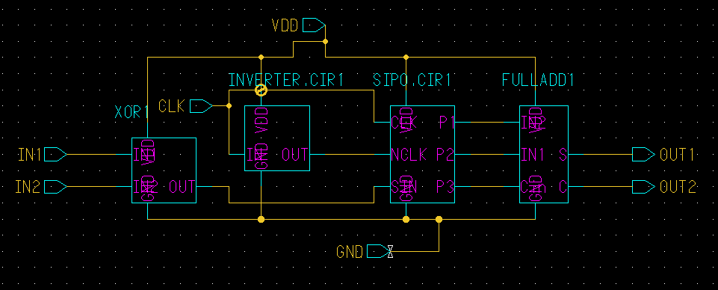
Block Diagram of Hamming Distance Calculator

Slide 9
Implementation
The design was segmented into multiple circuit modules and for each module the schematic and layout was designed.Finally the different modules were combined together to obtain a single schematic and layout.

Slide 10
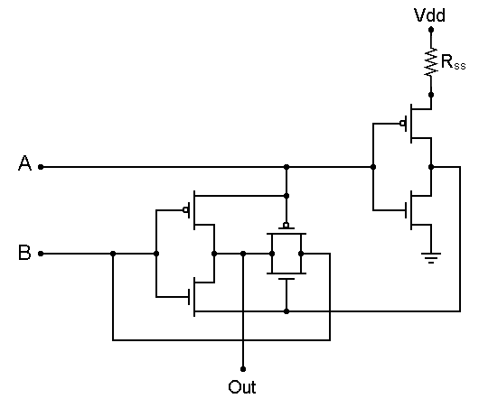
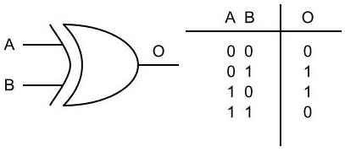
XOR
The first important module of the circuit is the XOR gate which is used in detecting the bit differences in the input sequences.

Slide 11
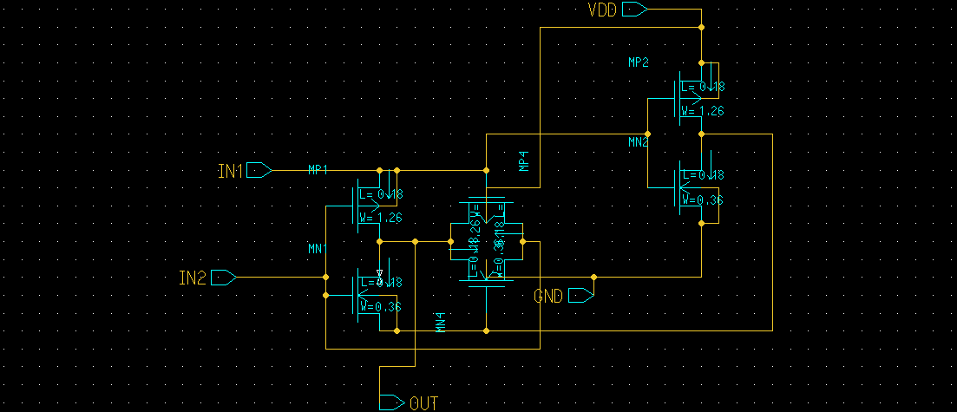
Schematic of XOR gate

Slide 12
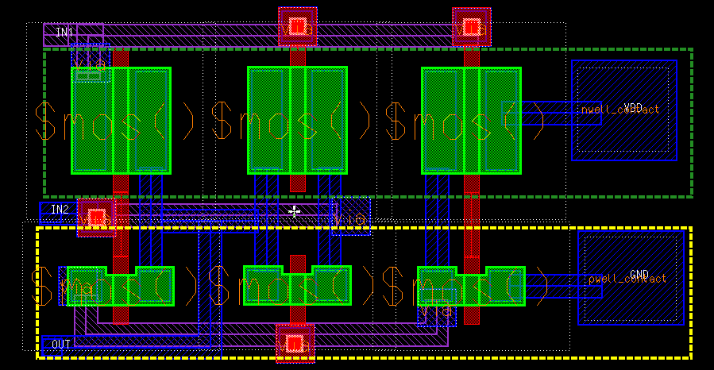
Layout of XOR gate

Slide 13
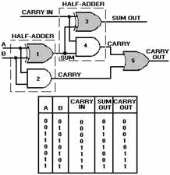
Full Adder
The circuit includes a full adder module which is used to sum up the number of bit differences in the two input sequence and calculate the hamming distance . It consists of two half adder modules connected using combinational logic.

Slide 14
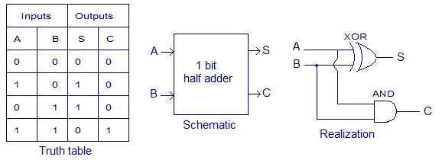
Half Adder
The half adder computes the sum and carry of two bits.For adding multiple bit numbers,half adders are generally employed.For the implementation of three bit full adder, two half adders were used along with an OR gate.

Slide 15
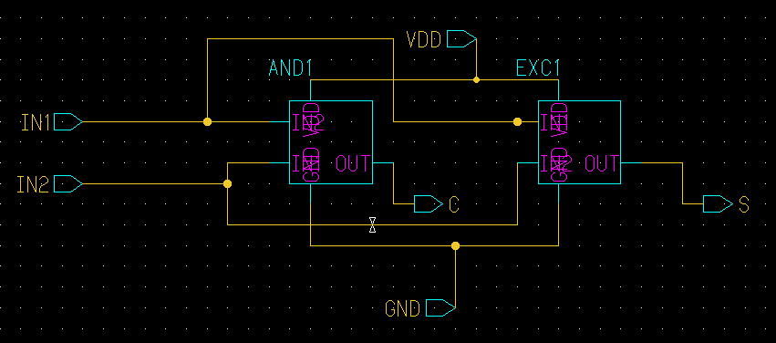
Block Diagram of Half Adder circuit

Slide 16
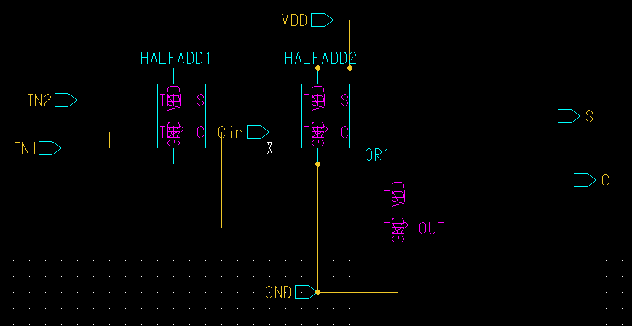
Block Diagram of Full Adder circuit

Slide 17
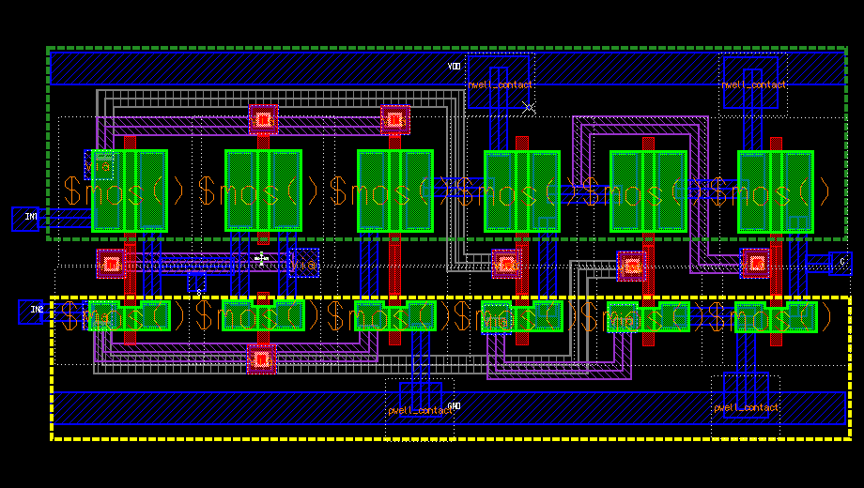
Layout of Half Adder circuit

Slide 18
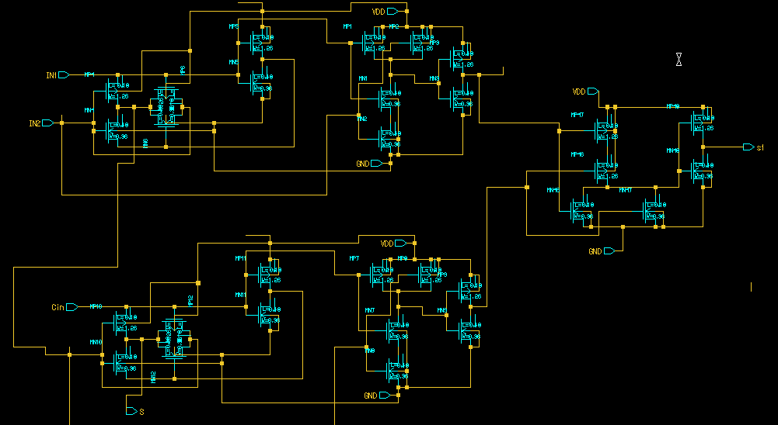
Schematic of Full Adder Circuit

Slide 19
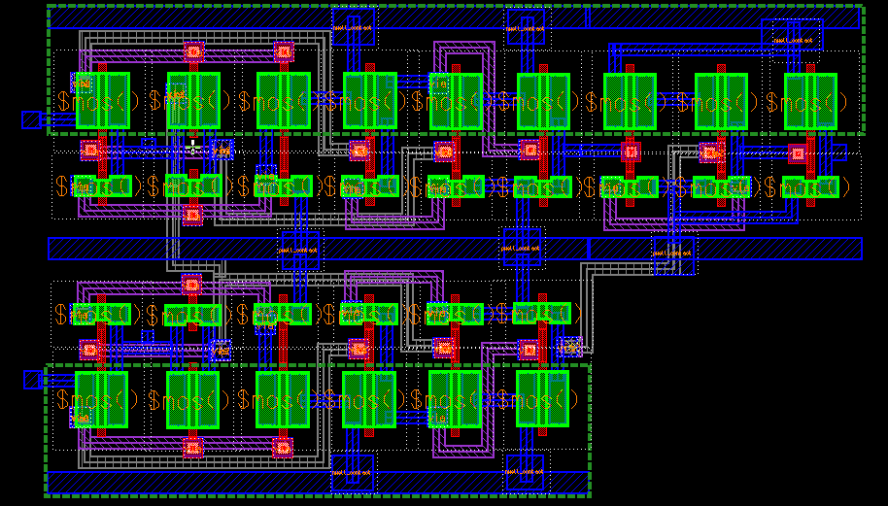
Layout of Full Adder Circuit

Slide 20
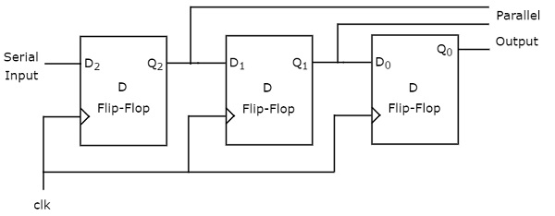
SIPO(Serial In-Parallel Out)
Serial In-Parallel Out circuit is a shift register which converts the serial inputs into parallel format.The register stores the input data of each stage and shifts the data at each clock cycle. Hence all the data are still available after a certain number of clock cycles.These data can be obtained in parallel form.

Slide 21
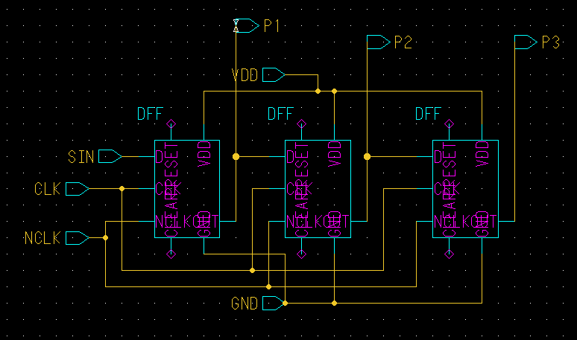
Block Diagram of SIPO

Slide 22
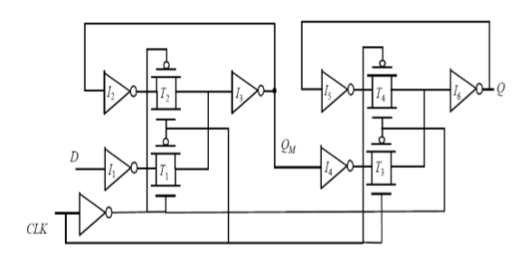
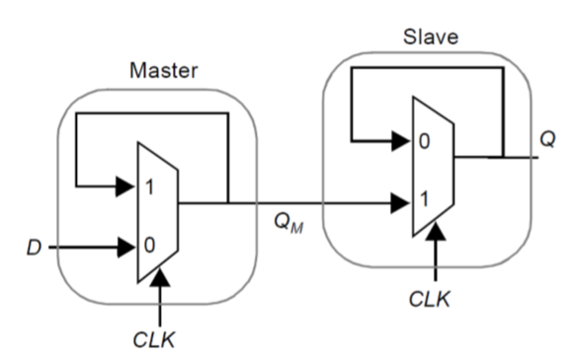
D-Flip Flop
The SIPO module consists of 3 D-Flip Flops(for 3 bits).A multiplexer based D Flip Flop is implemented in this circuit.

Slide 23
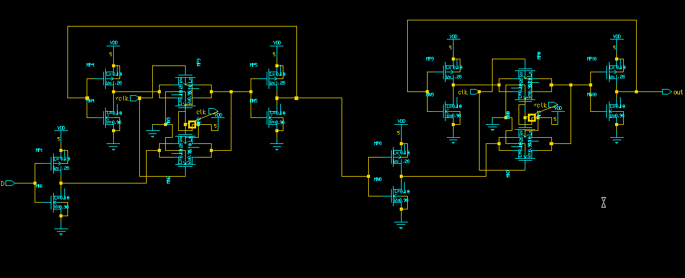
Schematic of D Flip Flop

Slide 24
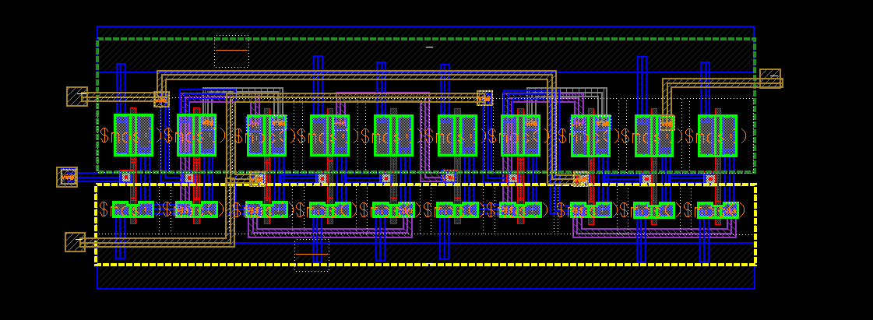
D FLIP-FLOP LAYOUT

Slide 25
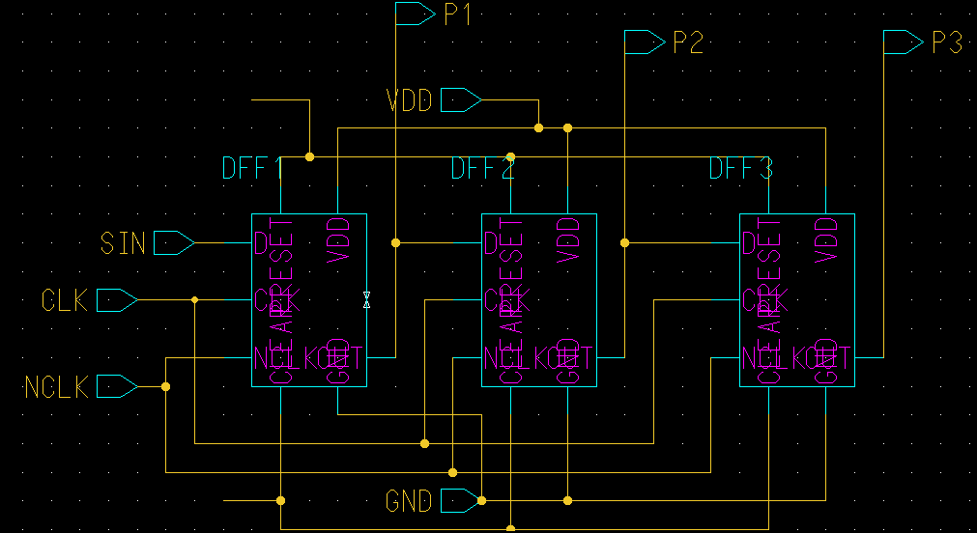
Schematic of SIPO circuit

Slide 26
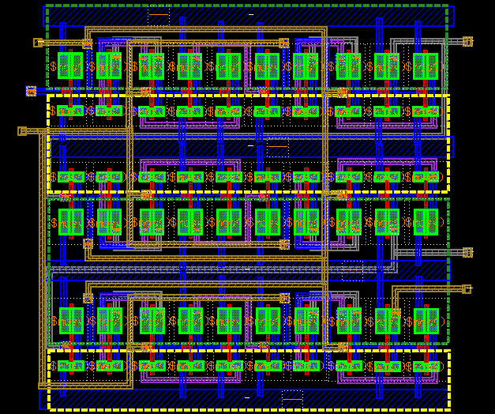
Layout of SIPO

Slide 27
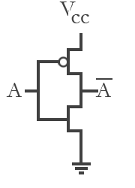
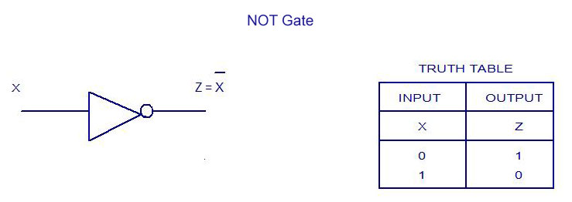
Inverter
The inverter circuit implements the NOT boolean logic.Here,an inverter circuit is required to invert the clock signal.

Slide 28
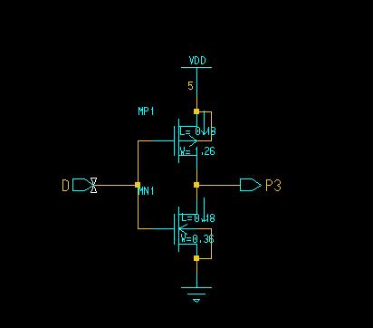
Schematic of Inverter circuit

Slide 29
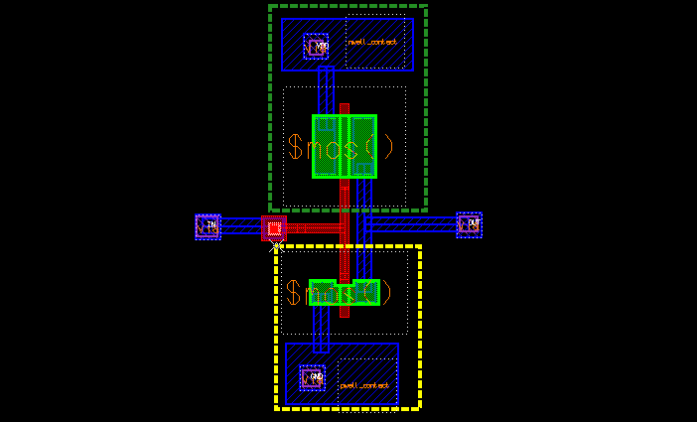
Layout of Inverter circuit

Slide 30
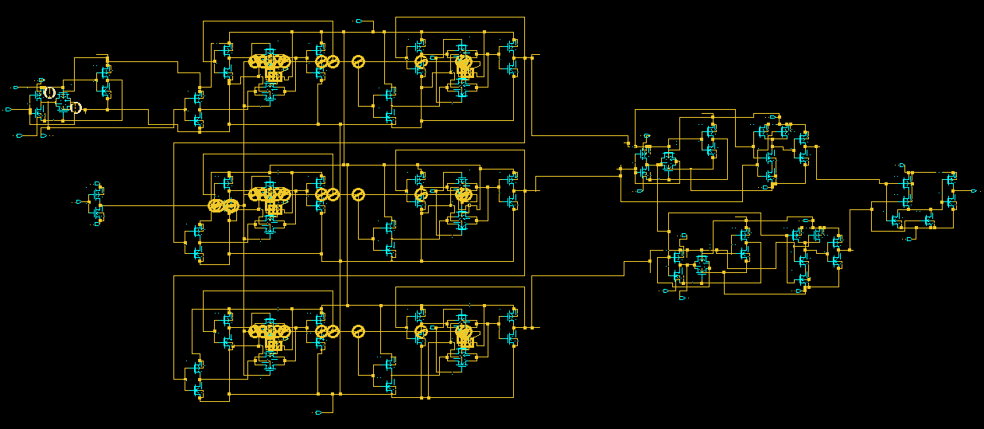
Entire schematic of hamming distance calculator circuit

Slide 31
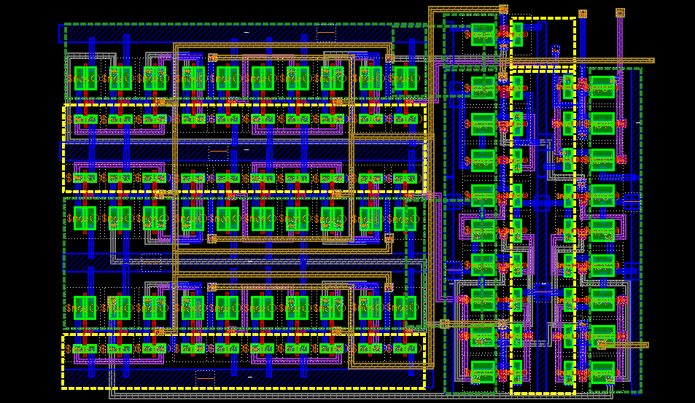
Entire Layout of hamming distance calculator circuit

Slide 32
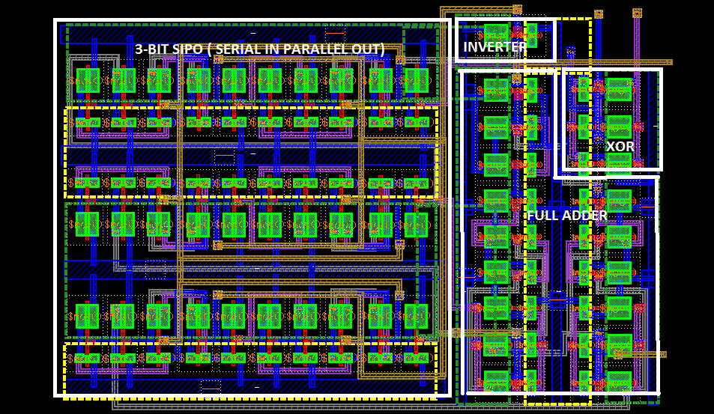
INDIVIDUAL BLOCKS IN FINAL LAYOUT

Slide 33
Observations
Schematic and Layout Outputs

Slide 34
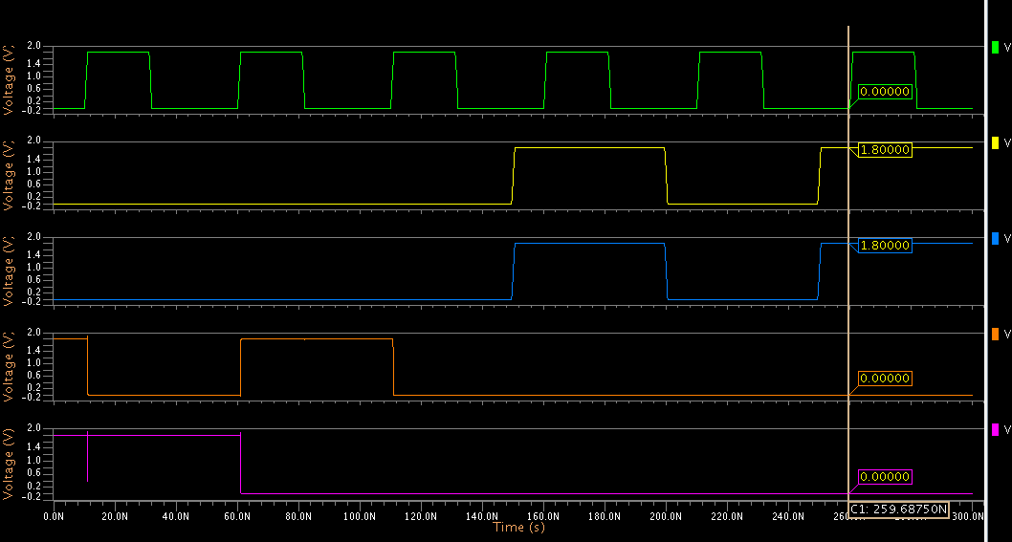
Simulation of the circuit schematic(input1=101,input2=101; output 00)

Slide 35
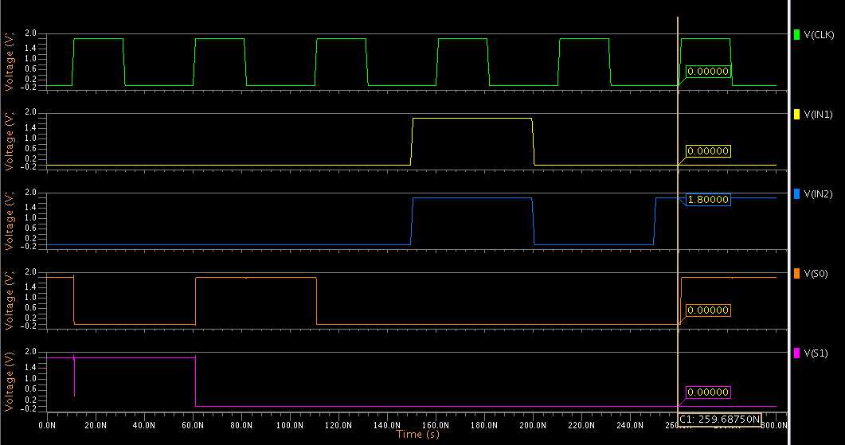
Simulation of circuit schematic(input1=100,input 2=101; output 01)

Slide 36
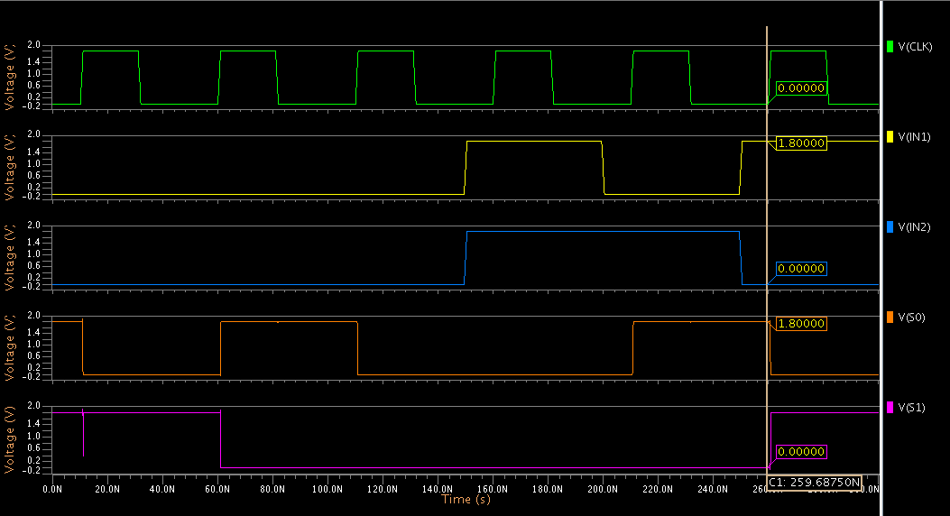
Simulation of circuit schematic(input1=101,input2=110; output 10)

Slide 37
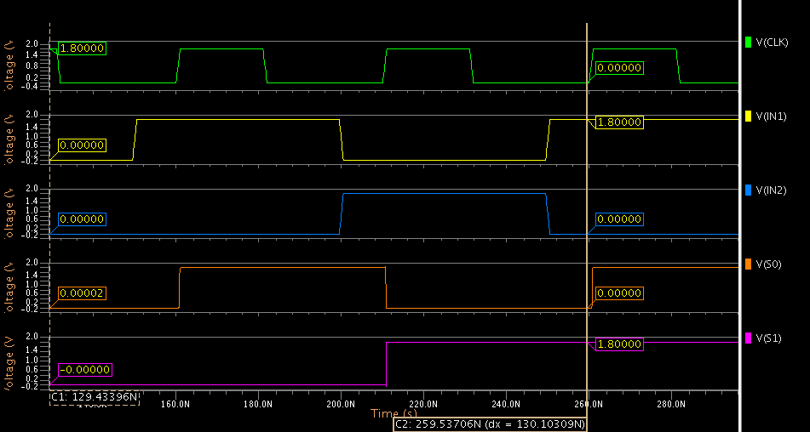
Simulation of circuit schematic(input1=101,input2=010; output 11)

Slide 38
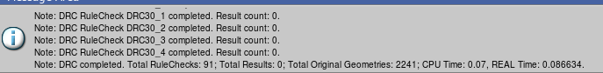
DRC Check for the hamming distance calculator circuit

Slide 39
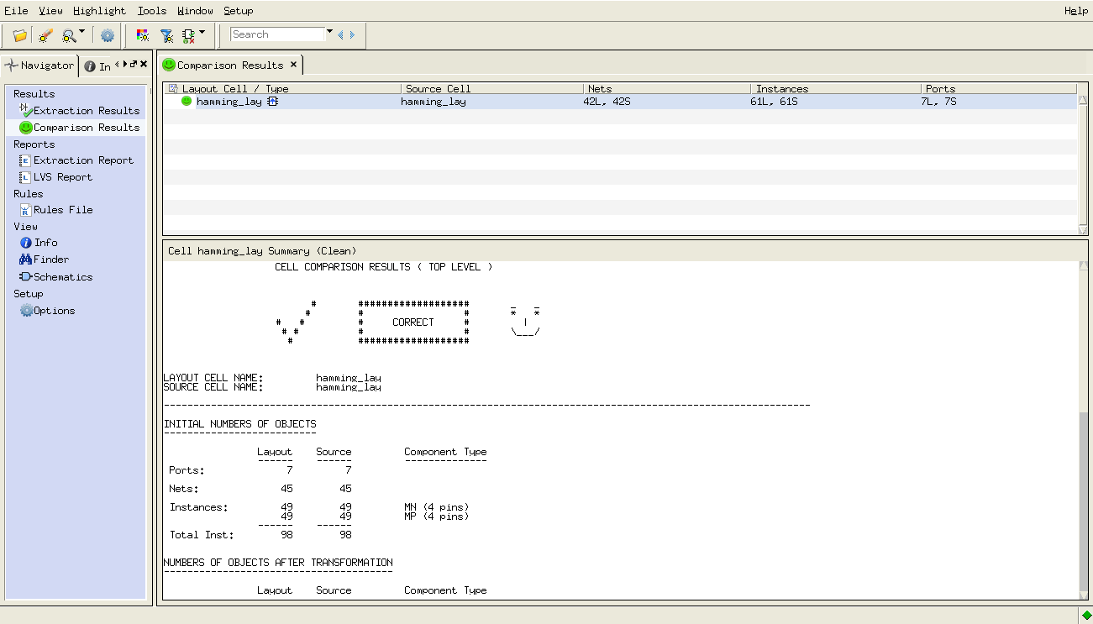
LVS Check of the hamming distance calculator circuit

Slide 40
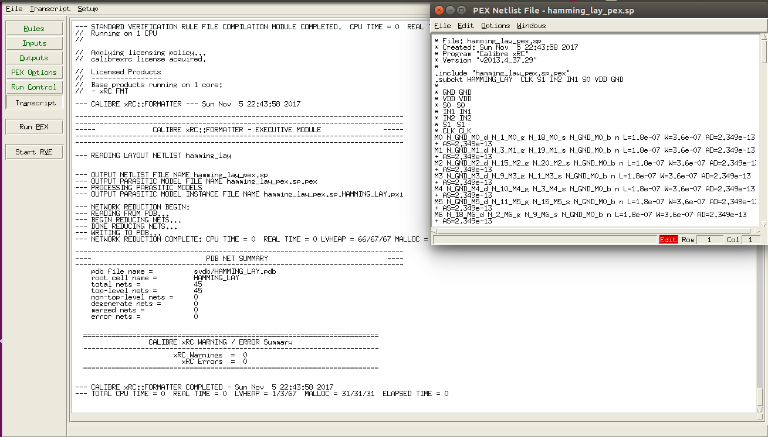
PEX Analysis of the circuit

Slide 41
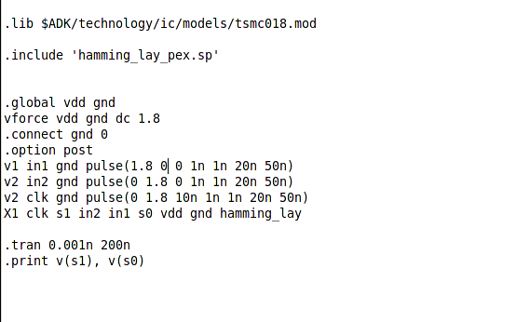
NG-Spice file to run layout

Slide 42
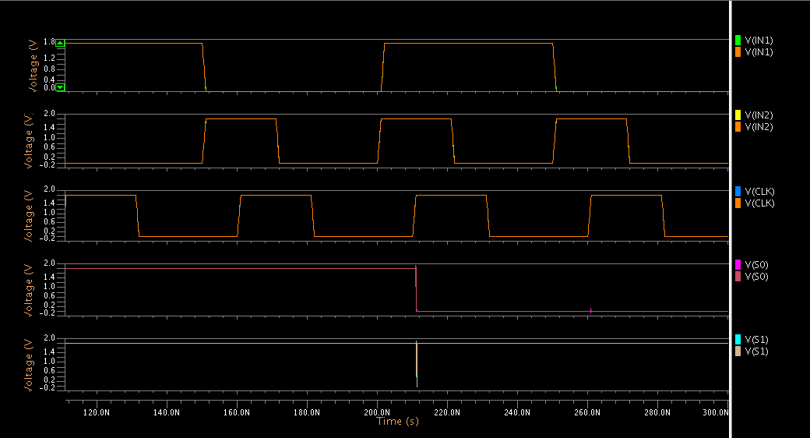
Overlapped simulation output from schematic and layout

Slide 43
Analysis

Slide 44
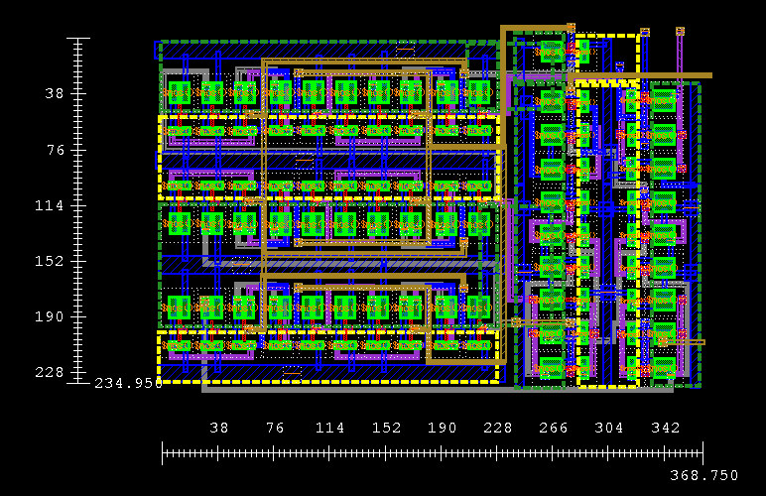
Area occupied : (42.29 X 66.37) 2807.065 Sq micro metres

Slide 45
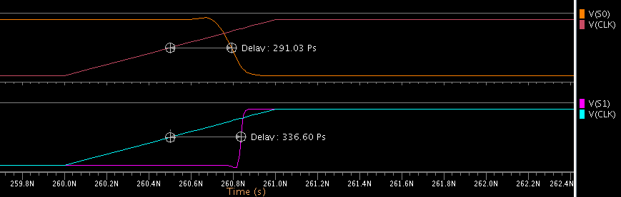
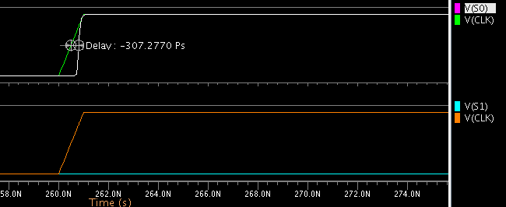
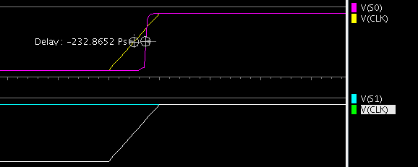
Delay Analysis
Delay when output is 01
S0: 291 PS S1: 336 PS
Delay when output is 10
S0: 307 PS S1: NA
Delay when output is 11
S0: 232 PS S1: NA
Worst Case Delays :
S0: 307 PS S1: 336 PS

Slide 46
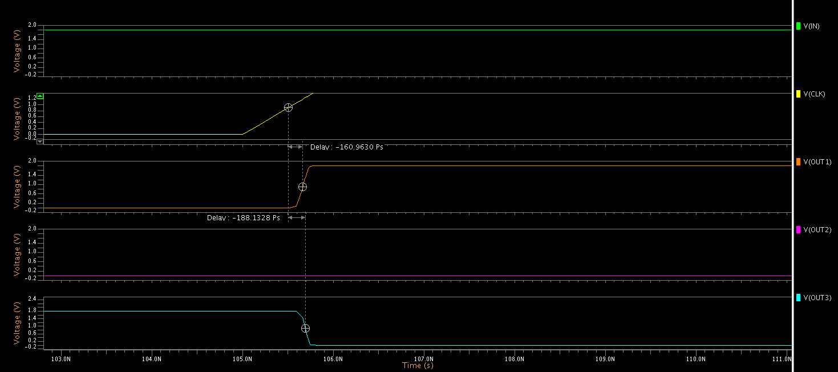
Delay observed in SIPO circuit

Slide 47
Delay observed in XOR circuit

Slide 48
Delay observed in FULL ADDER circuit

Slide 49
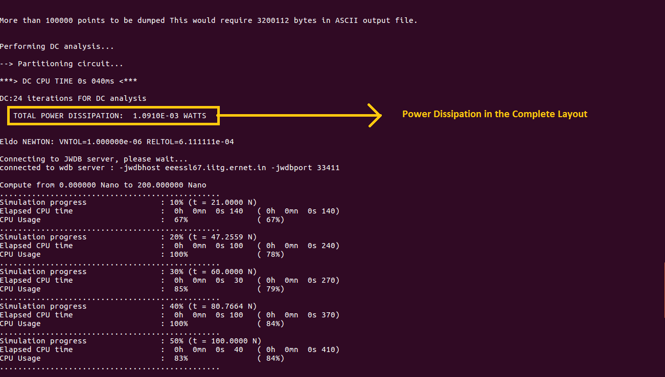
Power Analysis: Power dissipation results from ELDO simulation

Slide 50
Conclusions

Slide 51
Important Points
There is no poly metal overlap thereby decreasing the effective parasitic capacitance.
Area Optimisation by effective placements of power rails.
Transmission Gate logic is used to implement xor to minimise number of transistors.
Full Adder implemented using CMOS Logic Family to minimise static power consumption.
Transistor Density 28.64 transistors/sq.micro metre

Slide 52
Applications
Hamming Distance significantly used in error detection and correction of codes.
Signal Distance : Used in telecommunications to count number of flipped words in fixed length binary word to estimate error (Signal Distance).

Slide 53

Final point
Min Area: Pass Gate XOR
Min Power: CMOS Full Adder
Max Speed : Restructured Logic

Slide 54

Thank You!

